Slide 1
Ministry of Science and Higher Education of the Russian Federation FGBOU VO Rybinsk State Aviation Technical University named after P. A. Solovyov
Institute of «Information Technologies and Control Systems»
Department of Foreign Languages
«The Rise of Edge Computing: A Modern Way to Process Data»
Student of group IVM-24 Morozov A. A.
Professor c.p.n. docent Petrova L. A.

Slide 2





Relevance of edge computing
Growth of Connected Devices
Data Security Concerns
Real-Time Processing
Cloud Limitations
Industry Transformation

Slide 3

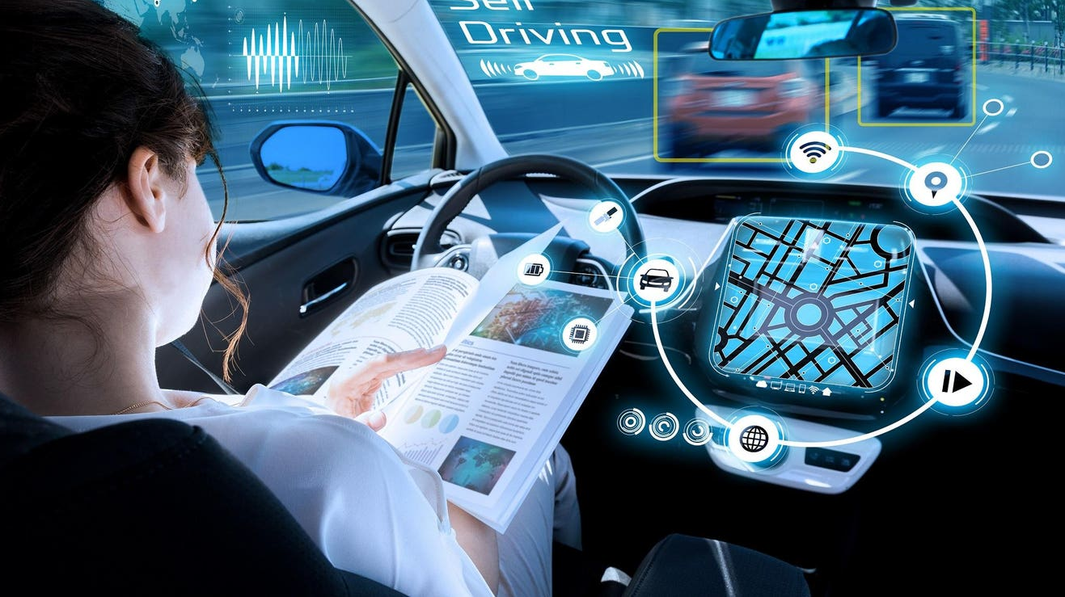



What is Edge Computing?
Edge computing is a new way to analyze and process data.

Slide 4



Key Advantages of Edge Computing
Improved Data Security
Faster Responses
Reduced Internet Bandwidth Usage
Resilience During Outages

Slide 5





Real-World Applications of Edge Computing
Healthcare
Retail
Energy
Entertainment
Government and Military-industrial complex

Slide 6

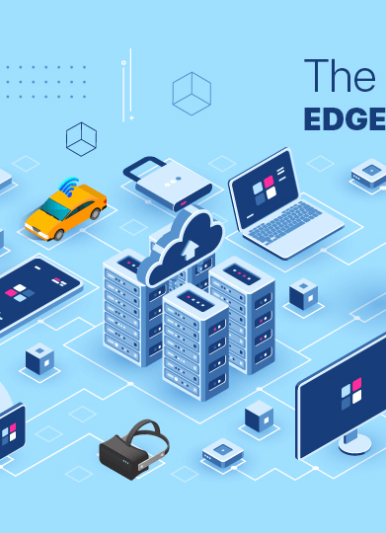
The Future of Edge Computing
Edge AI
5G technology
Internet-of-Things

Slide 7
Thank you for your attention
The presentation was prepared by a student of the IVM-24 group Morozov A. A.

